Slide 1

Identifying Overvalued and Undervalued Soccer Players Relative to In Season Performance
By Kosta Marcopulos

Slide 2

Objective
Help football clubs identify players who are overvalued, undervalued, or valued within reason relative to their performances in the season. This will be done by comparing a player rating relative to market value.

Slide 3

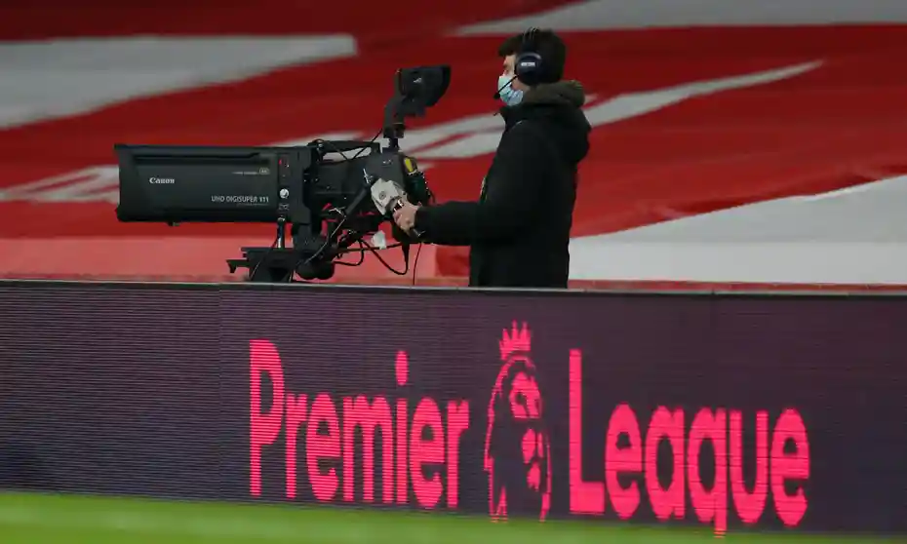

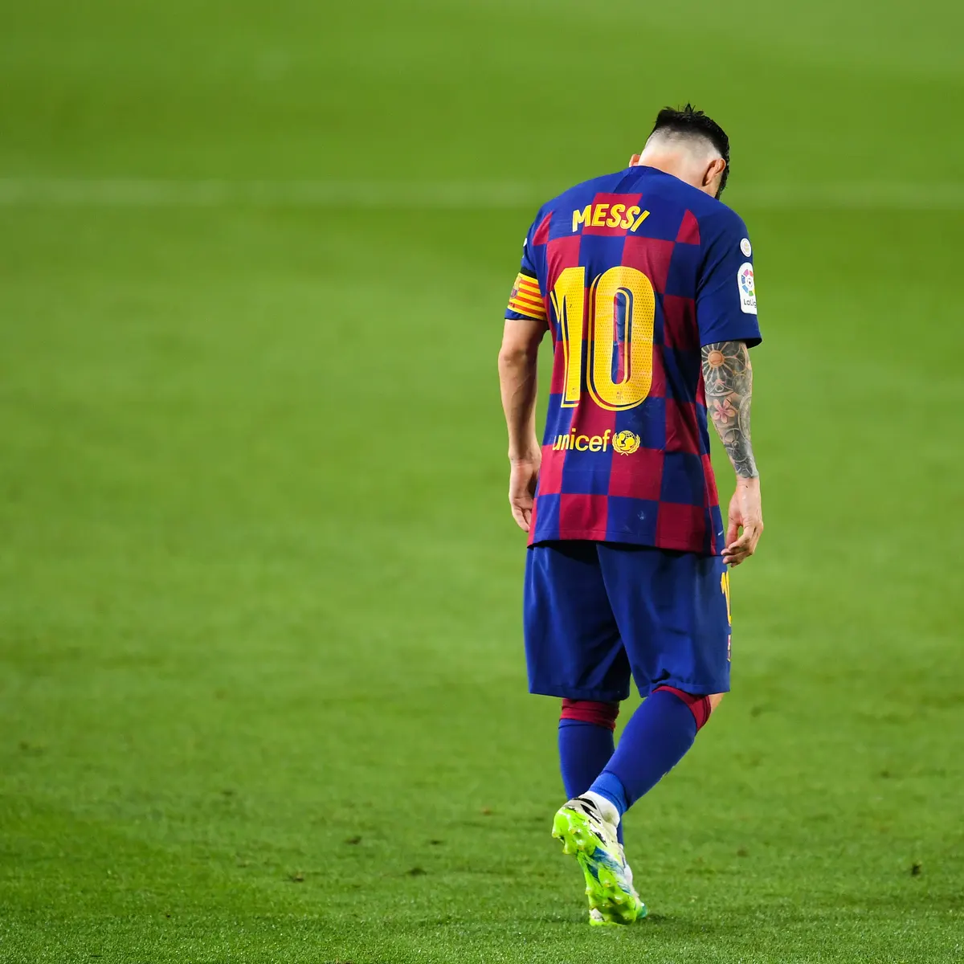
Why Is This Important?

Slide 4
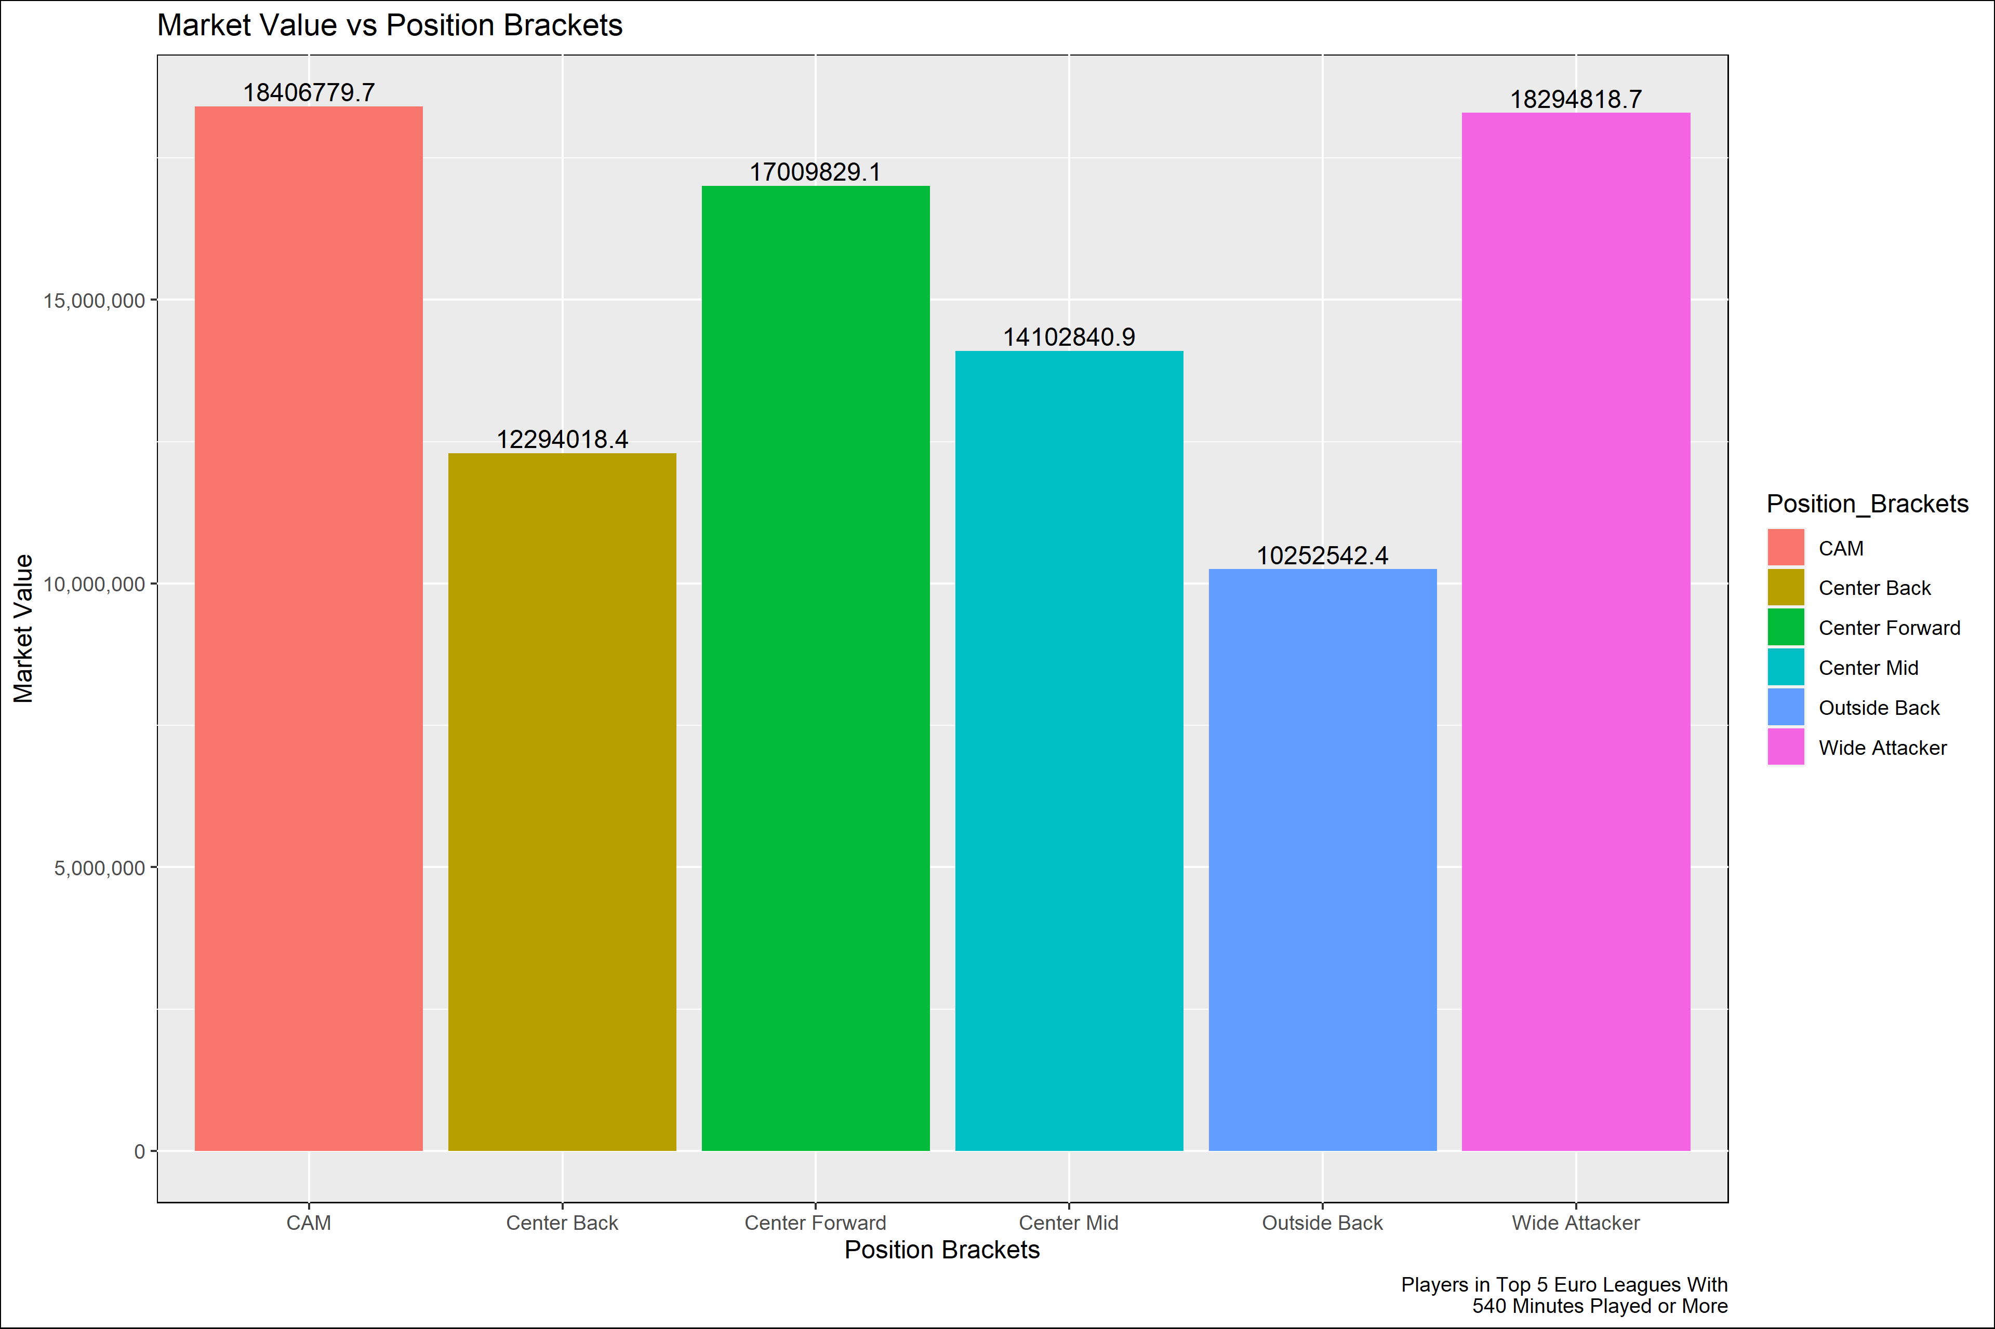
Generating a Player Rating
Discovered the correlation of overall team metrics to points. These will act as weights in our formula.
Example – Goals had the highest correlation to points at 0.88.
Grouping players into position brackets.
Center Forward – for center forwards
CAM – for central attacking midfielders
Center Mid – for central and defensive midfielders
Center Back – for center backs
Outside Back – for outside backs and wing backs
Wide Attacker – for wing players and wide attacking midfield options.

Slide 5

Generating a Player Rating
Labeling players with a development status based on age & position.
Developing – players who are below peak ages for their position bracket.
Peak – players who are in their peak ages for their position bracket.
Veteran – players who are beyond the peak ages of their position bracket.
Developing players have a weighted value of 1.5, peak players have weighted value of 1.25, and veteran players have a weighted value of 1.0.
Brackets created using study by Tom Worville at The Athletic. https://theathletic.com/2935360/2021/11/15/what-age-do-players-in-different-positions-peak/

Slide 6
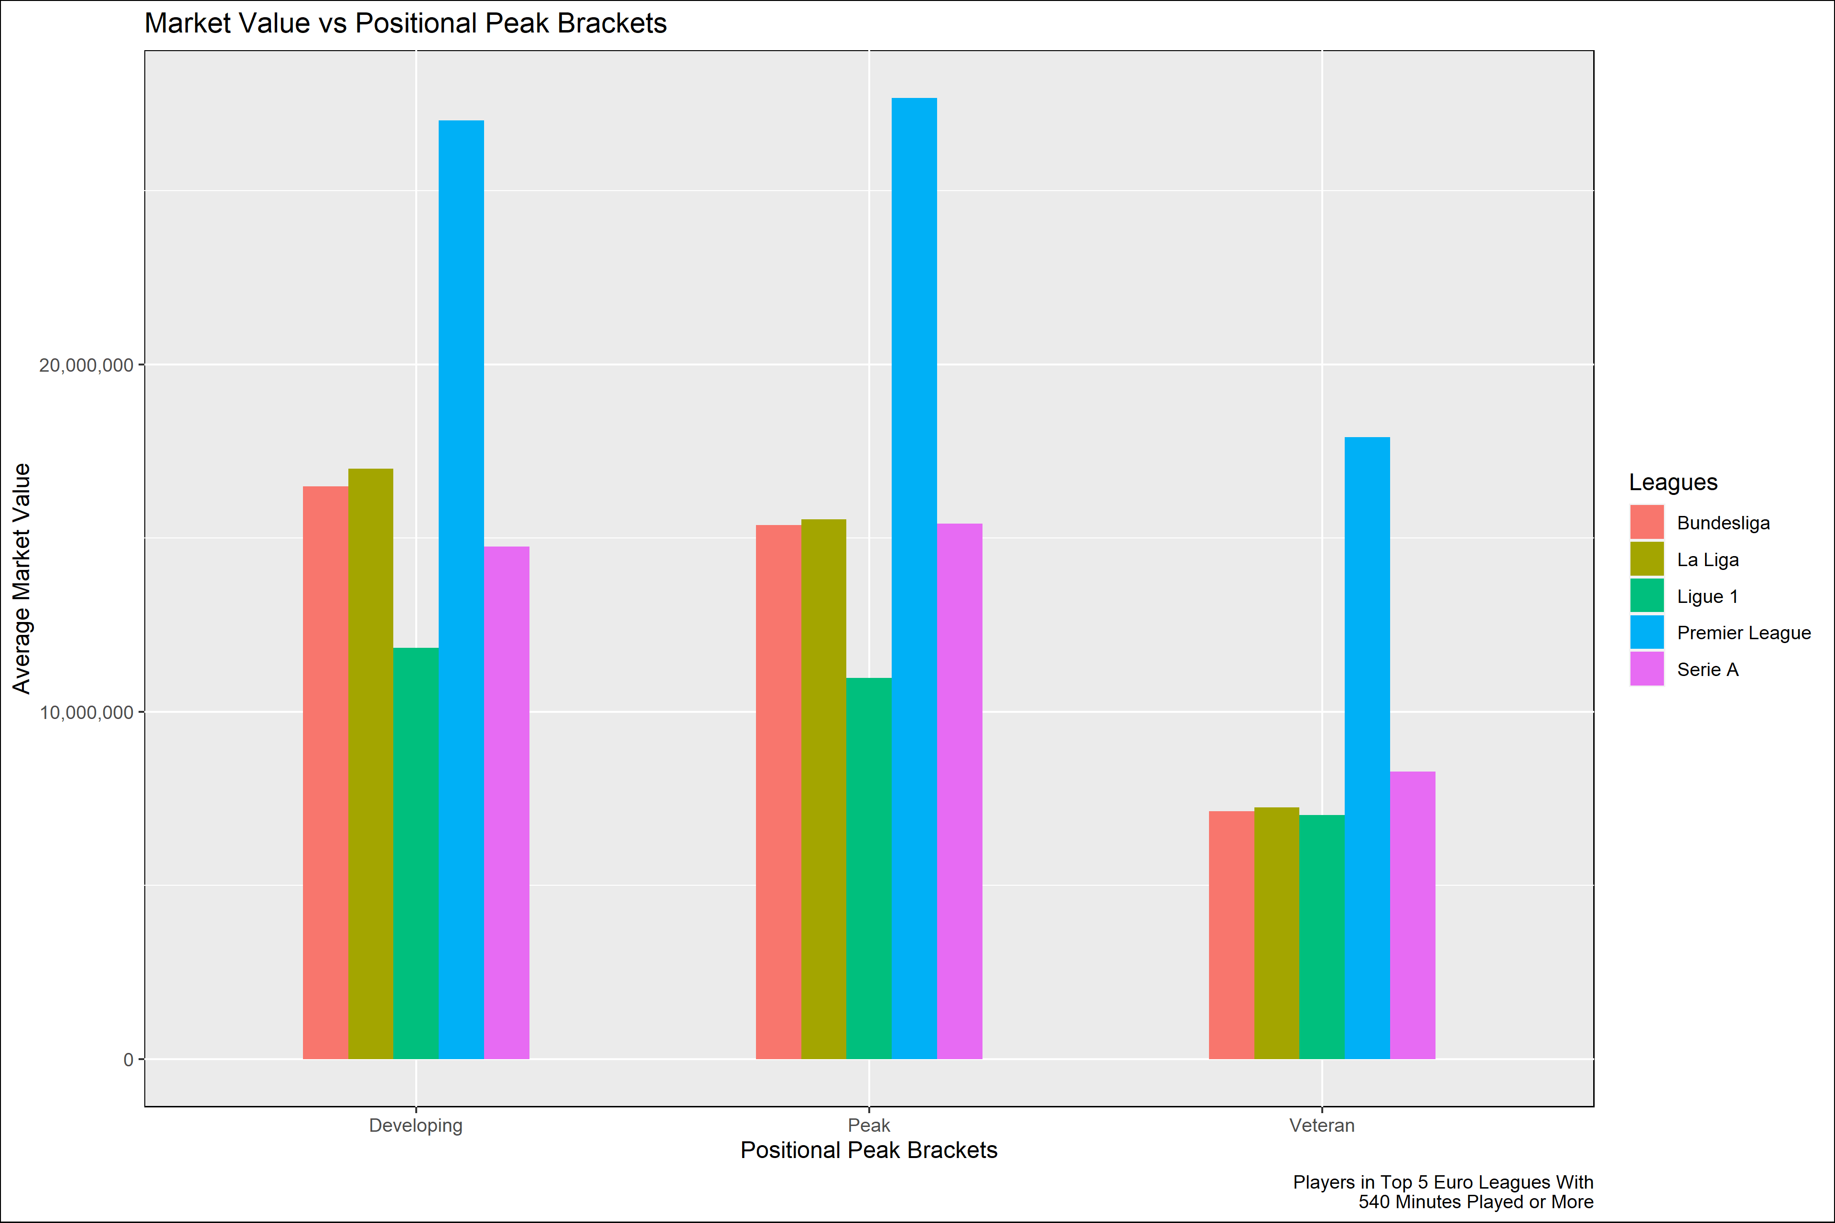
Generating a Player Rating
Leagues | Position Peaks | Average Market Value
Bundesliga | Developing | $ 16,490,816
Bundesliga | Peak | $ 15,372,464
Bundesliga | Veteran | $ 7,140,476
La Liga | Developing | $ 17,002,597
La Liga | Peak | $ 15,537,500
La Liga | Veteran | $ 7,242,500
Ligue 1 | Developing | $ 11,838,400
Ligue 1 | Peak | $ 10,976,190
Ligue 1 | Veteran | $ 7,030,952
Premier League | Developing | $ 27,016,304
Premier League | Peak | $ 27,666,667
Premier League | Veteran | $ 17,903,509
Serie A | Developing | $ 14,754,455
Serie A | Peak | $ 15,420,000
Serie A | Veteran | $ 8,273,770

Slide 7
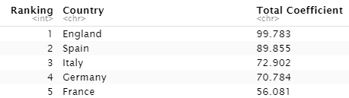

Generating a Player Rating
Applying a league weight based on difficulty of league.
Initial metrics were found using UEFA league coefficients.
Final league weight is 0.25 * UEFA league coefficient.
https://en.wikipedia.org/wiki/UEFA_coefficient
Convert all player metrics to percentiles based on position bracket.

Slide 8
Generating a Player Rating
Apply one of the following formulas to our metrics:
Percentile * ((Correlation +/- 1) * 2)
Percentile * ((1 + abs(Correlation) )* 2)
Use of the second formula applies to metrics that may be bad for a team, but strong for a player.
Split data frames by position brackets and select KPIs that best fit the position. Future use allows for flexibility.
Use the following formula to calculate a player rating:
(rowSums(rows relating to player data) + League Coefficient Weight) * Position Peak Weight

Slide 9

Valuation Labels
Overvalued
Within Reason - if a player’s residual is between 0% and 20% of their market value, their market value is within reason of the performances this season.
Slightly Overvalued - if a player’s residual is between 20.01% and 30% of their market value, they are slightly overvalued relative to their season performance.
Significantly Overvalued – if a player’s residual value is greater than 30.01% of their market value, they are significantly overvalued relative to their season performance
Undervalued
Within Reason – if a player’s residual value is between 0% and -20% of their market value, their market value is within reason of the performances this season.
Slightly Undervalued – if a player’s residual is between -20.01% and -30% of their market value, they are slightly undervalued relative to their season performance.
Significantly Undervalued – if a player’s residual value is less than -30.01% of their market value, they are significantly overvalued relative to their season performance.

Slide 10
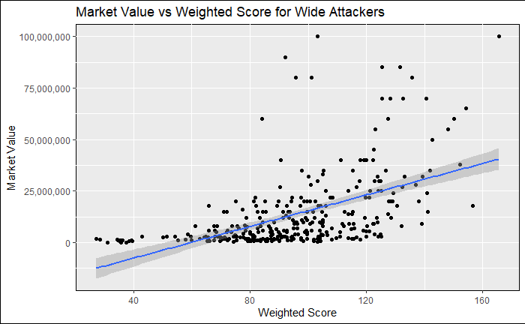
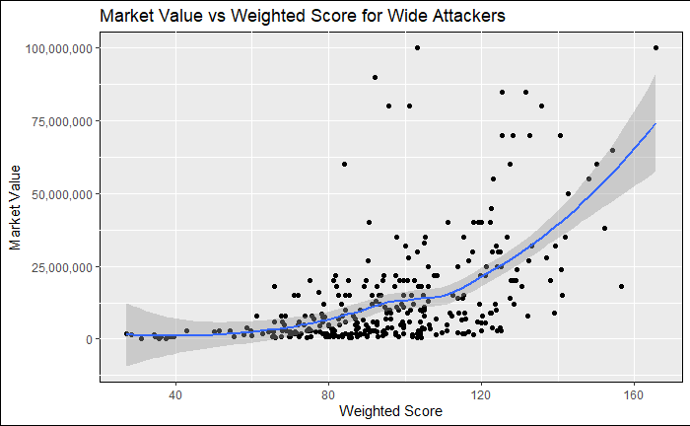
Line of Best Fit - Loess

Slide 11
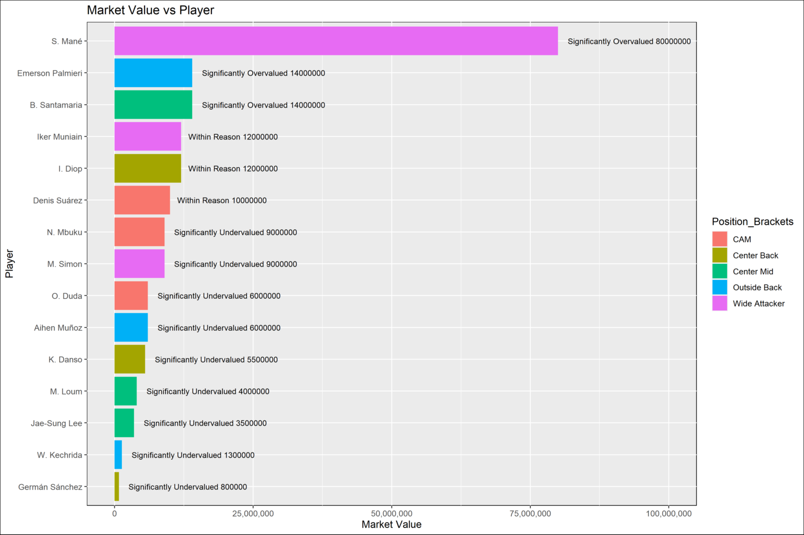
Evaluation
Each positional bracket has at least 2 valuation labels.
Labels next to the bar display the valuation bracket along with the players market value.

Slide 12
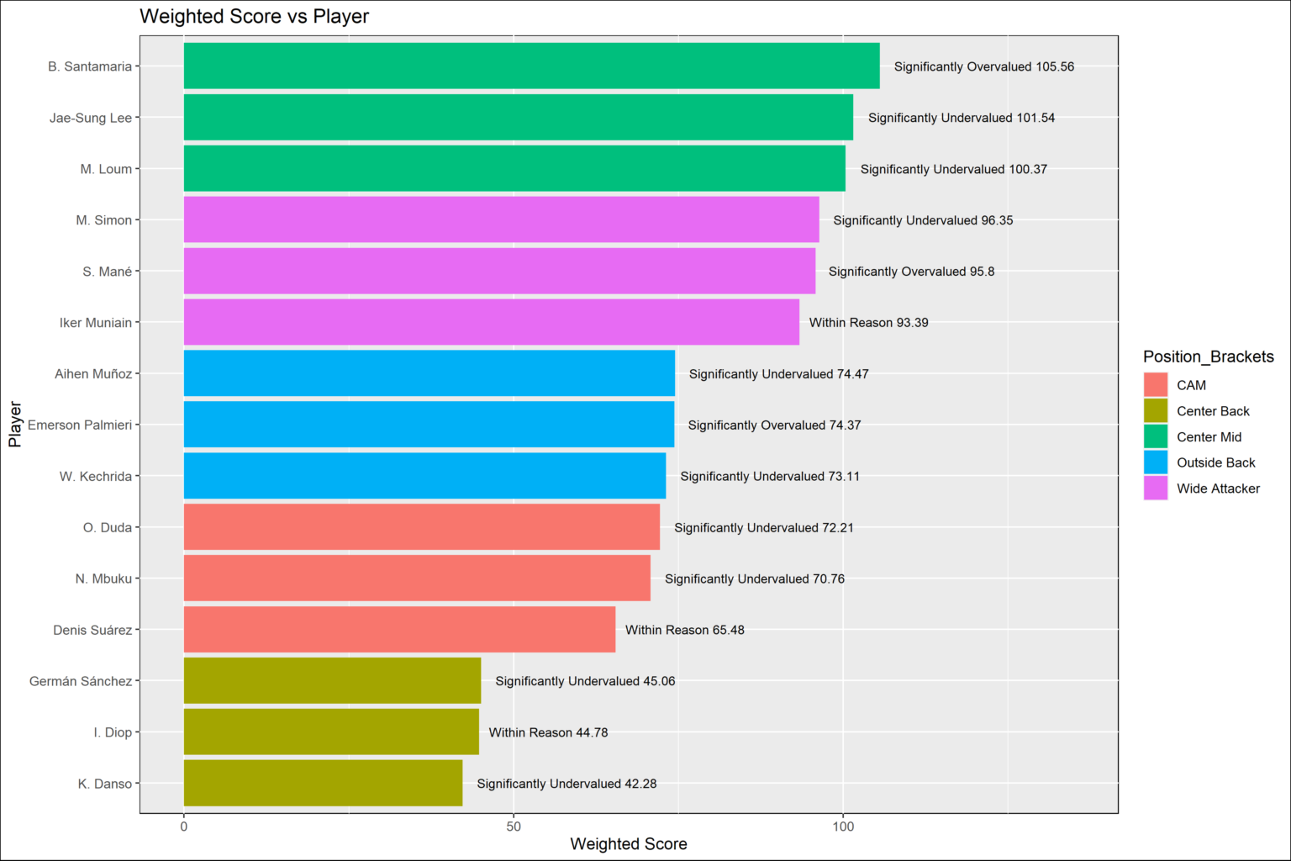
Evaluation
More features selected lead to a larger weighted score. Evident with central midfielders, as they had the most features selected due to variety of play styles.
Graph shows the random players selected all have similar weighted scores. As we saw on the previous graph, market values within each position bracket differed.
Labels next to the bar display each players valuation label and their weighted score.

Slide 13
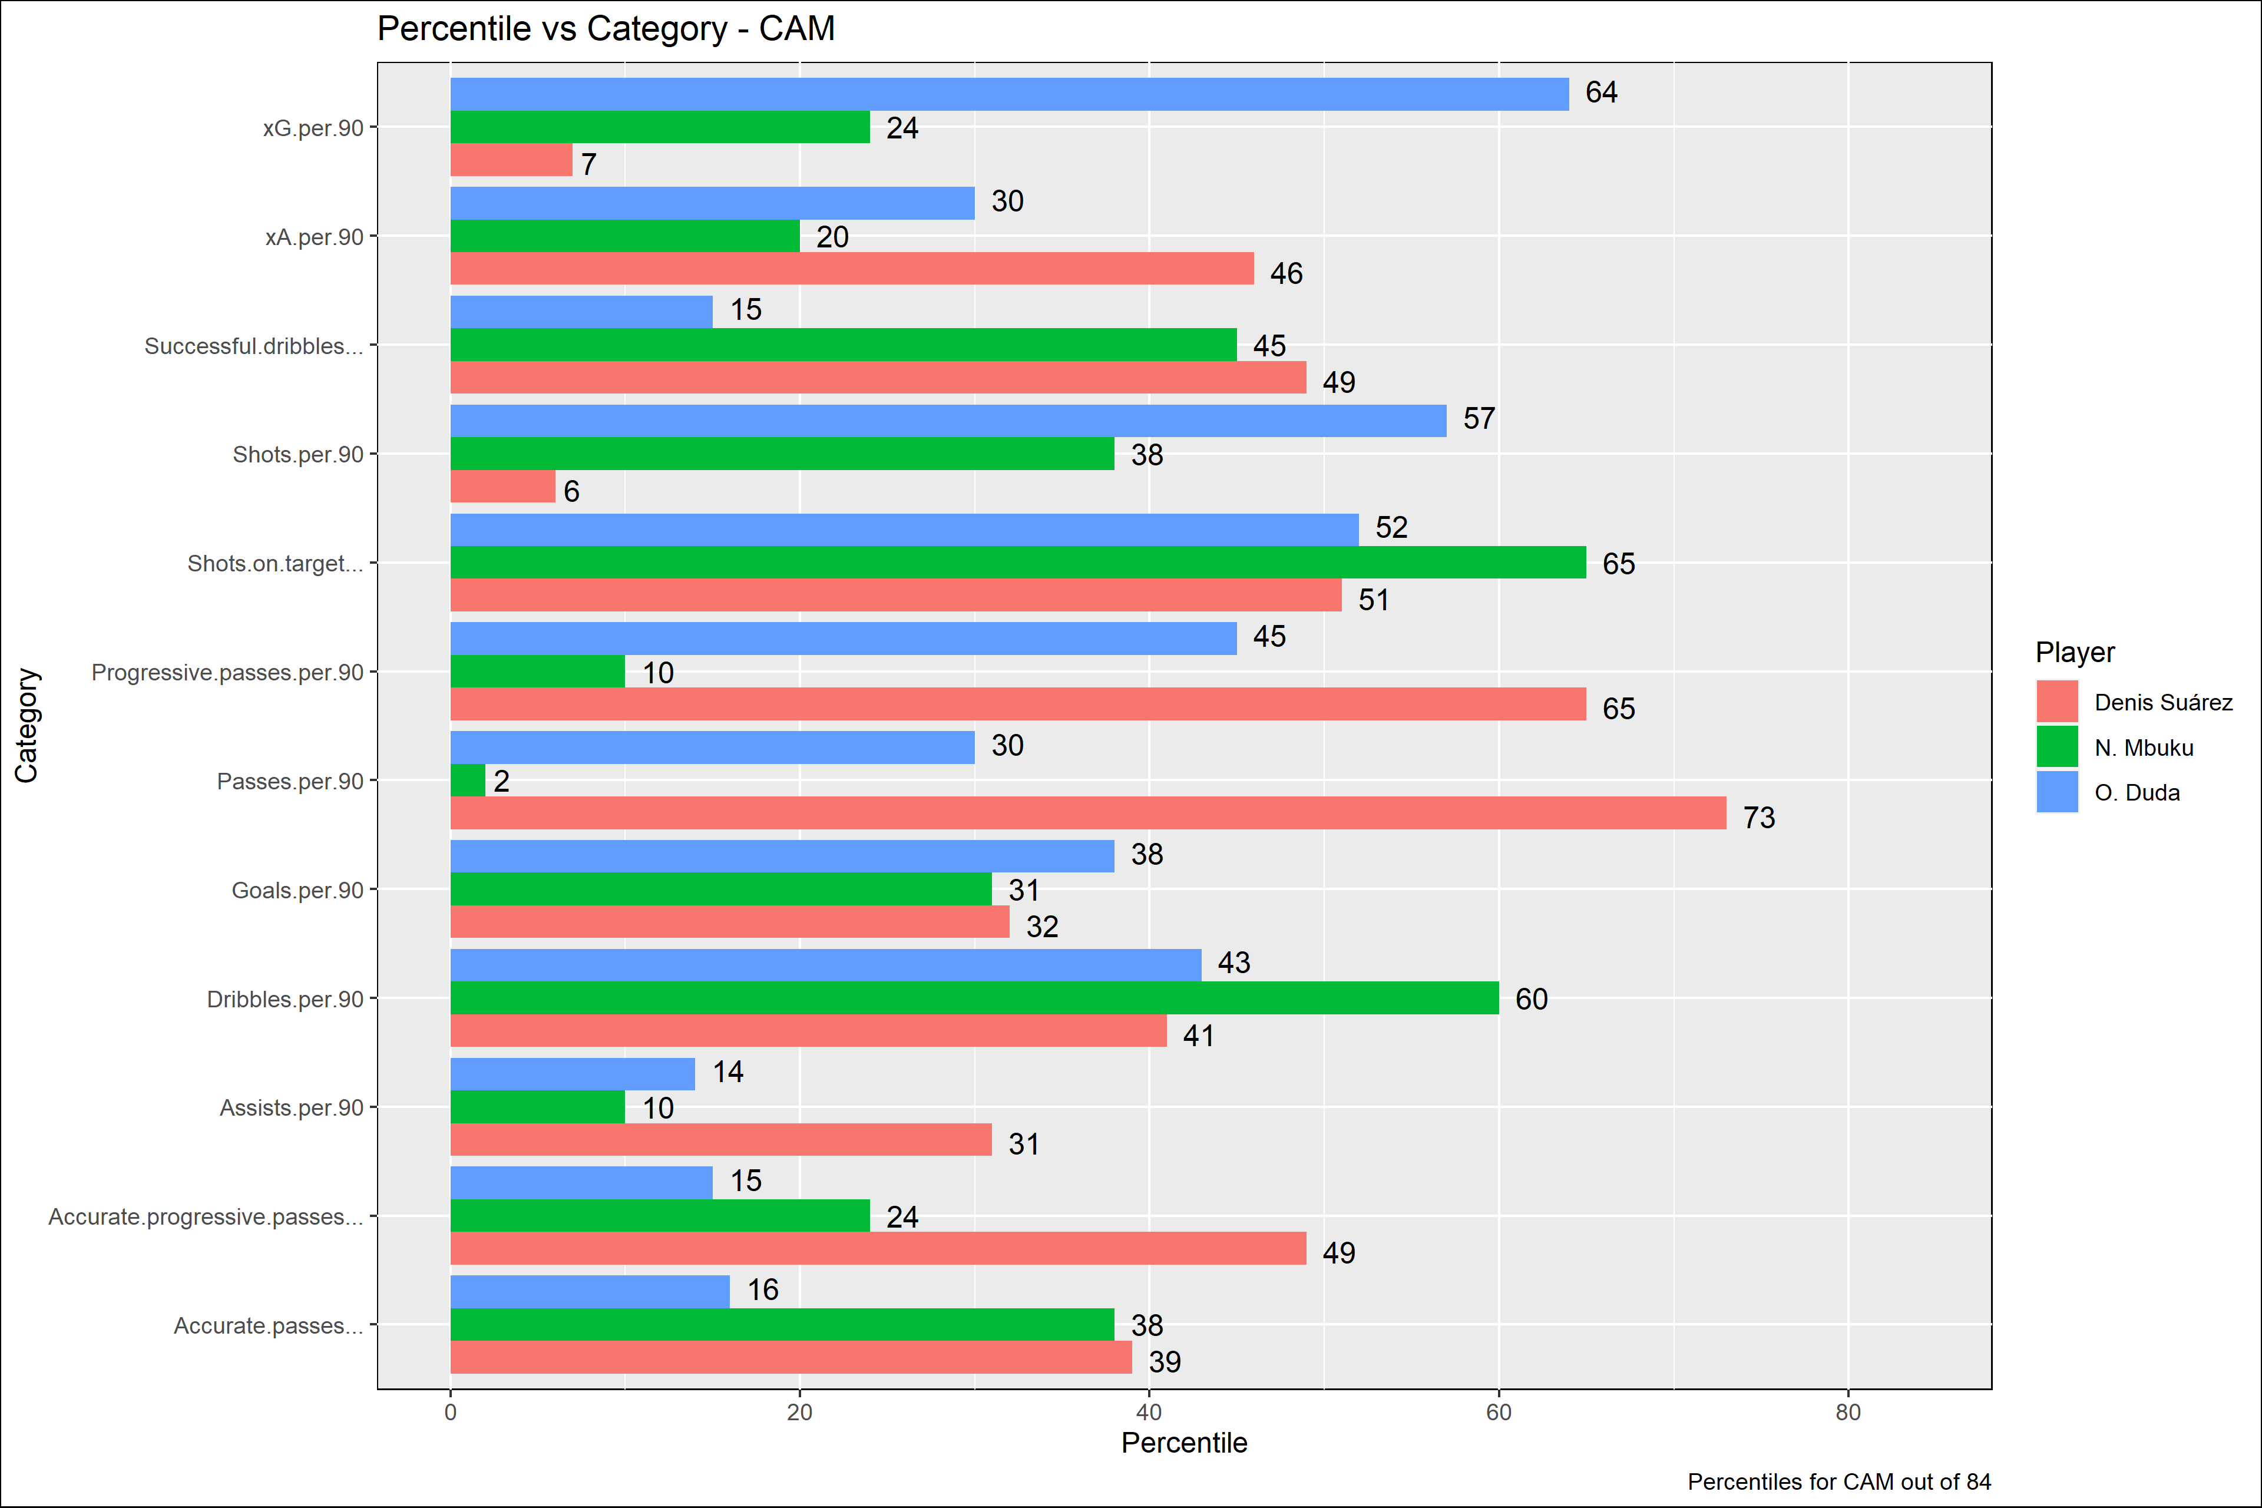
Evaluation - CAM
Duda is a strong shooter of the ball. Respectable shot volume and shot % on target has led to an xG per 90 that sits around the 3rd quartile for the position. Since we know goals come at a premium when it comes to point generation, he could be a great addition for a team looking to improve their goal tally.
Suarez sits around the middle of the pack in most categories. However, he has a high pass output per 90 along with a strong desire to play the ball progressively. His overall pass accuracy leaves more to be desired.
Mbuku gets a lot of his shots on target and attempts to dribble defenders but is subpar in most other key categories. However, he is only 19 years old and falls into the developmental category. In this case, it may be worth evaluating the player further with a scouting report. This will allow us to judge the player by in game performances and see if he shows a high potential.
The valuation labels for Duda and Suárez seem accurate relative to their market value. Mbuku's ratings are a bit underwhelming relative to valuation label and market value, but it is important to note that he is extremely young at 19 years old. For this reason, an in person scouting report would be more indicative of potential upside relative to his current market value.
O. Duda - $6,000,000; Significantly Undervalued
Denis Suárez - $10,000,000; Within Reason
N. Mbuku - $9,000,000; Significantly Undervalued

Slide 14
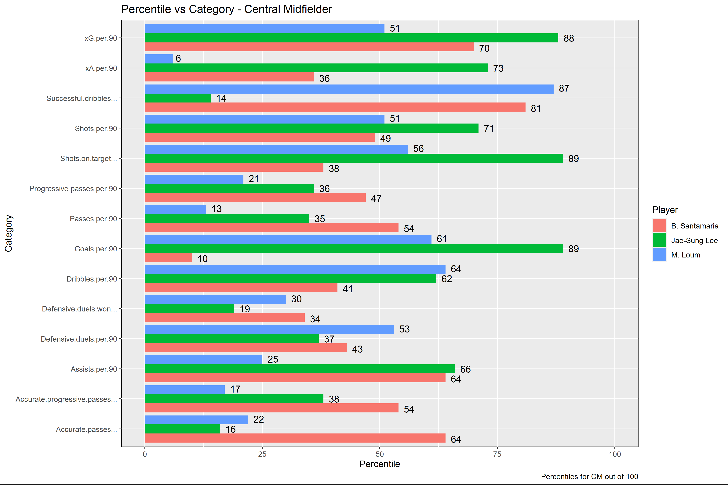
Evaluation – Central Mid
The most obvious standout in this is Jae-Sung Lee. Valued at $3,500,000, his goal related metrics are amongst the strongest in the top 5 leagues for the central midfield position bracket. In addition to this, he has generated a respectable amount of assists per 90, with an expected assist metric that sits near the 3rd quartile. Although his passing and dribbling abilities are lacking, his ability to contribute to a team's goal tally at a cut rate price justify his valuation label.
On the contrary, Santamaria has a market value 400% greater than Lee. He is currently in his peak age bracket, but only his successful dribble percentage is at a top level. With that being said, he attempts a low amount of dribbles per 90 indicating he is not be a player who dribbles often. Although his xG per 90 metric sits just shy of the 3rd quartile, there doesn't seem to be a justifiable reason to spend so much on him when other viable options are available at a cheaper price. His valuation label of significantly overvalued seems warranted.
B. Santamaria - $14,000,000; Significantly Overvalued
M. Loum - $4,000,000; Significantly Undervalued
Jae-Sung Lee - $3,500,000; Significantly Undervalued

Slide 15
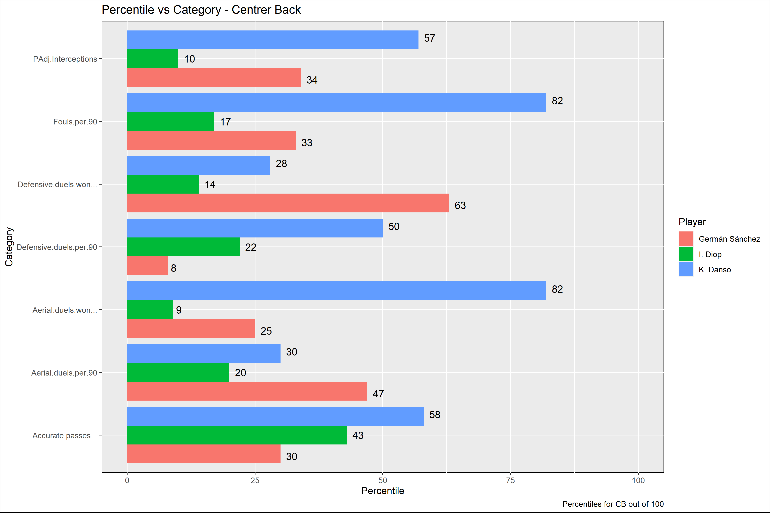
Evaluation – Center Back
In the case of all 3 center backs randomly selected, no player jumps out as a must sign target. With the exception of Danso's ability to win aerial duels, all positive KPIs for the players displayed are around the the middle or back of the pack for their respective position.
Diop's valuation label of "Within Reason" is extremely generous and should be rejected by a club. His performances in game do not warrant the highest valuation of the trio, as he consistently has a lower percentile rating compared to his peers.
Germán Sánchez is an interesting case. Although his percentiles at a high level, he has a respectable defensive duel win %. He is 35 years old and considered a veteran, while having one of the lowest market values in the position. This would warrant his label of "Significantly Undervalued", as a team on a tight budget can look to him as an option to bolster squad depth.
I. Diop - $12,000,000; Within Reason
K. Danso - $5,500,000; Significantly Undervalued
Germán Sánchez - $800,000; Significantly Undervalued

Slide 16
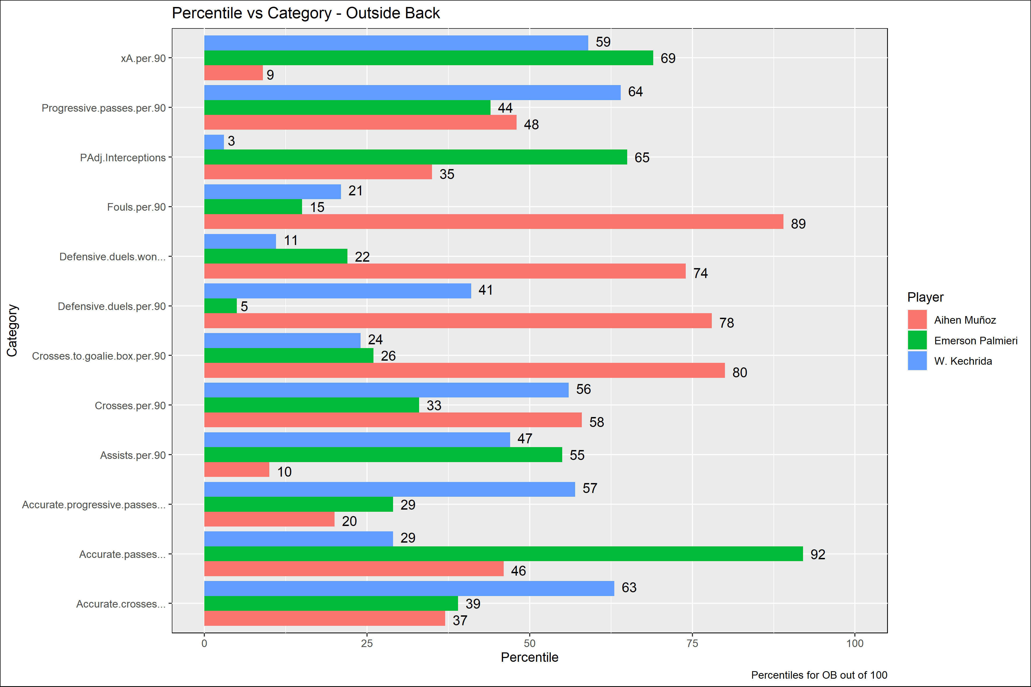
Evaluation – Outside Back
Emerson Palmieri has the highest market value of the trio. His largest strength comes from his ability to pass the ball accurately, which is and rated in the 92nd percentile. However, his defensive metrics are abysmal. His defensive duel win % doesn't even reach the 1st quartile. He would be much more useful on a team that allow fullbacks to get forward freely with minimal defensive duties. However, as he just exited his peak years, we believe his label of "Significantly Overvalued" is warranted.
On the flip side, Muñoz has extremely strong defensive duel metrics sitting around the 3rd quartile in defensive duels per 90 and defensive duels won. His accuracy is worse than that of Emerson, but his general cross output and crosses into the goalie box are far higher. Pair this with the fact that he just entered his peak years at the age of 24 and you have a full back whose market value is below his playing ability. In theory, his ability should continue to progress over the coming years under the right guidance. This progression in skill should coincide with a rise in market value, allowing for a club to make a potential profit down the road.
Emerson Palmieri - $14,000,000; Significantly Overvalued
Aihen Muñoz - $6,000,000; Significantly Undervalued
W. Kechrida - $1,300,000; Significantly Undervalued

Slide 17
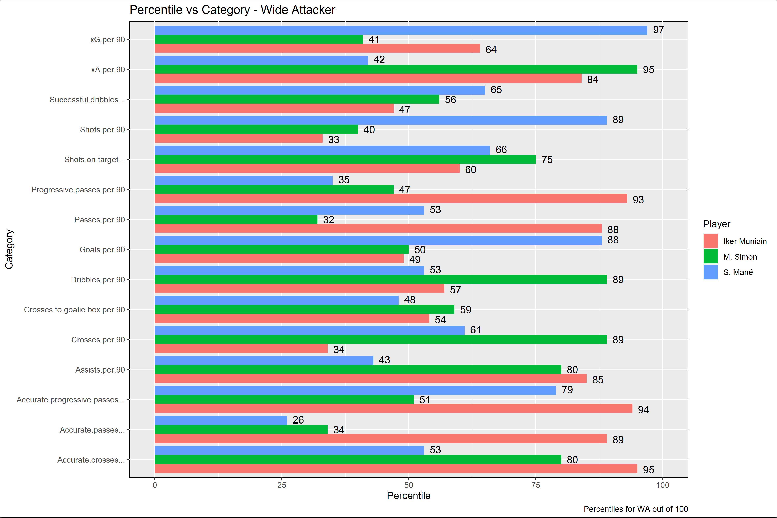
Evaluation – Wide Attacker
Sadio Mané is one of the most famous names in world football. His success at Liverpool includes titles in both the Premier League and Champions League. Mané shines most in his shooting/goal scoring abilities. His xG per 90, goals per 90, and shots per 90 are all at a minimum of the 88th percentile. However, he sits around the median for most other key metrics. In addition to this, his accurate pass % is at an abysmal level sitting at the 26th percentile. Although his goal scoring ability is elite, he is currently 29 years old and will most likely see his market value drop significantly as he goes through his early thirties. For these reasons, we believe his label of "Significantly Overvalued" is warranted.
Mané's market value is listed as being over 650% greater than the other two players on this list. Despite this valuation, both Muniain and Simon provide significant value to their sides and are extremely strong in other KPIs. For example, Munian's passing and assist related metrics are consistently at the 84th percentile or higher. In addition to this, Simon is an excellent crosser of the ball and has generated an xA metric at an elite level in the 95th percentile. He is also in his peak years and would be expected to maintain or grow in market value throughout. For these reasons, we believe the valuation labels for both Munian and Simon are correct. These are players who can be brought in, have a significant output for the team, and the difference in cost between them and Mané can be reinvested in other areas of the squad. Overall, a stronger squad should have more of an impact on point generation than an individual player.
S. Mané - $80,000,000; Significantly Overvalued
Iker Muniain - $12,000,000; Within Reason
M. Simon - $9,000,000; Significantly Undervalued

Slide 18
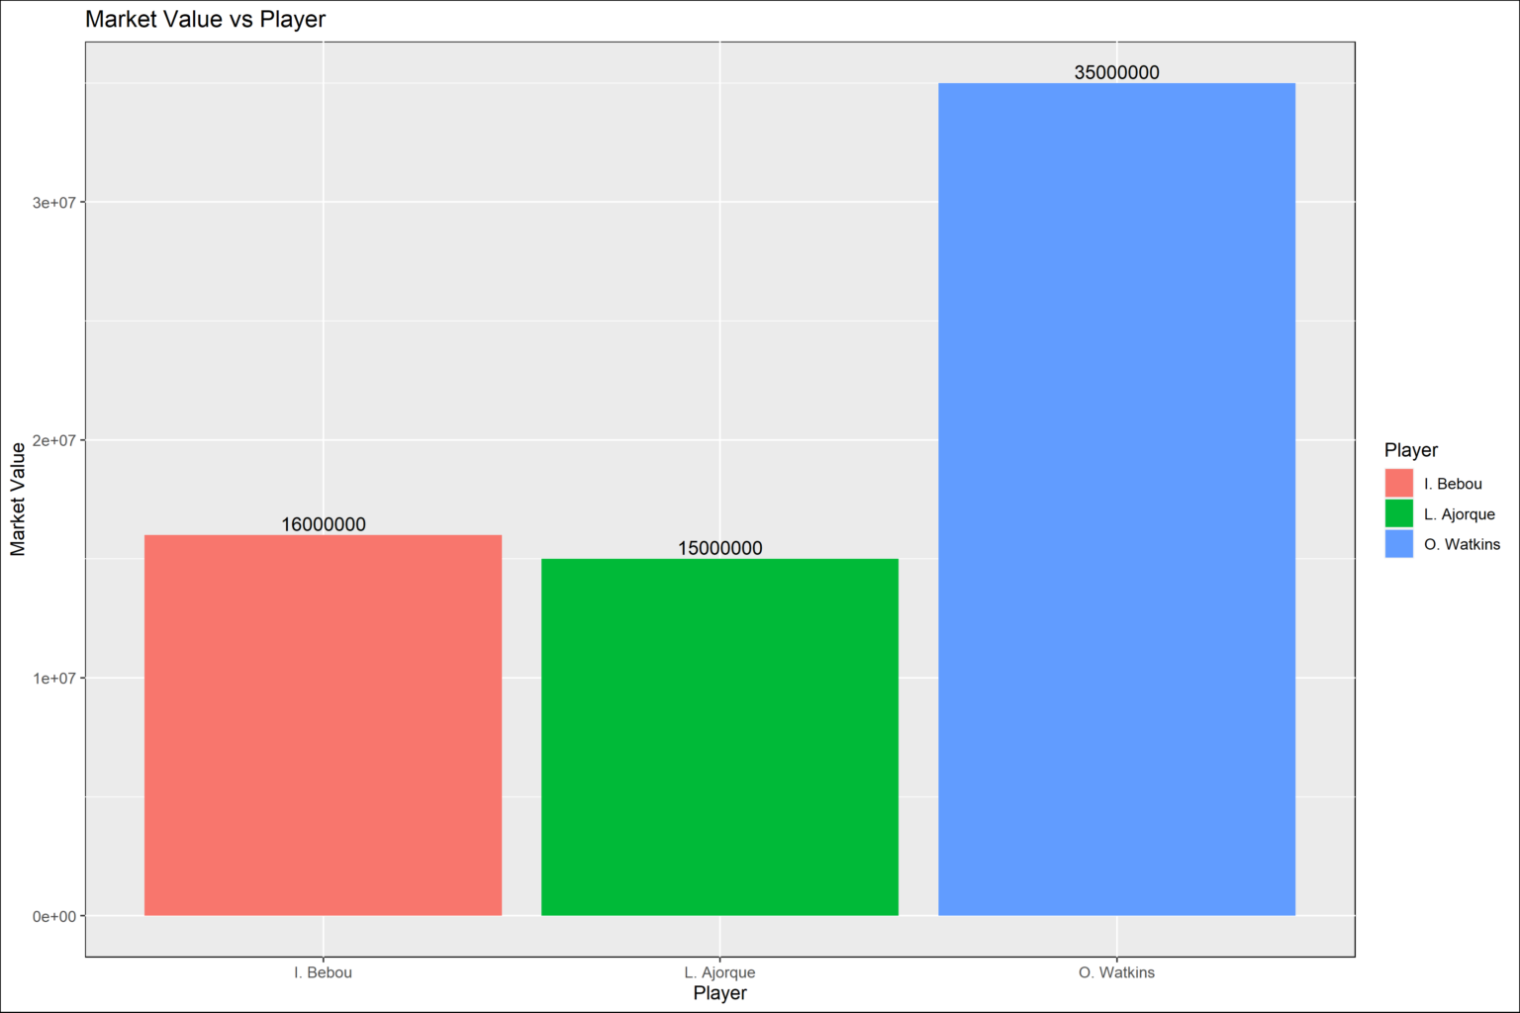
Deployment – A Premier League Club Looking to Sign a Center Forward

Slide 19
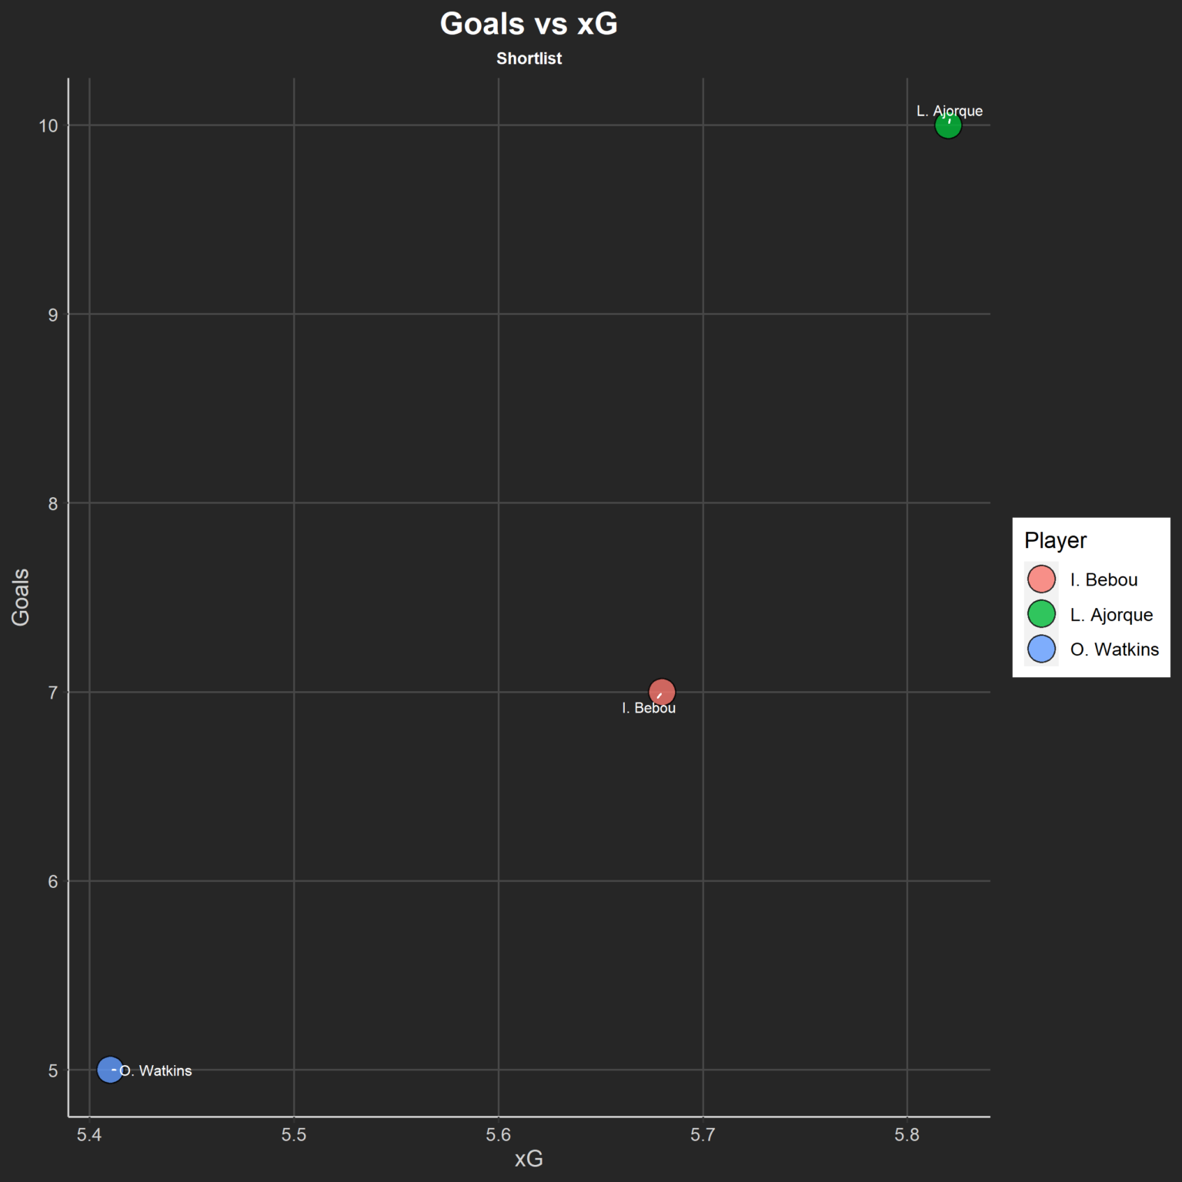
Deployment – A Premier League Club Looking to Sign a Center Forward
All players have very similar xG metrics. Watkins is right on par with his xG, scoring 5 goals. Bebou is slightly over performing his xG, scoring 7 goals. Ajorque is nearly doubling his xG, scoring 10 goals so far this season.

Slide 20
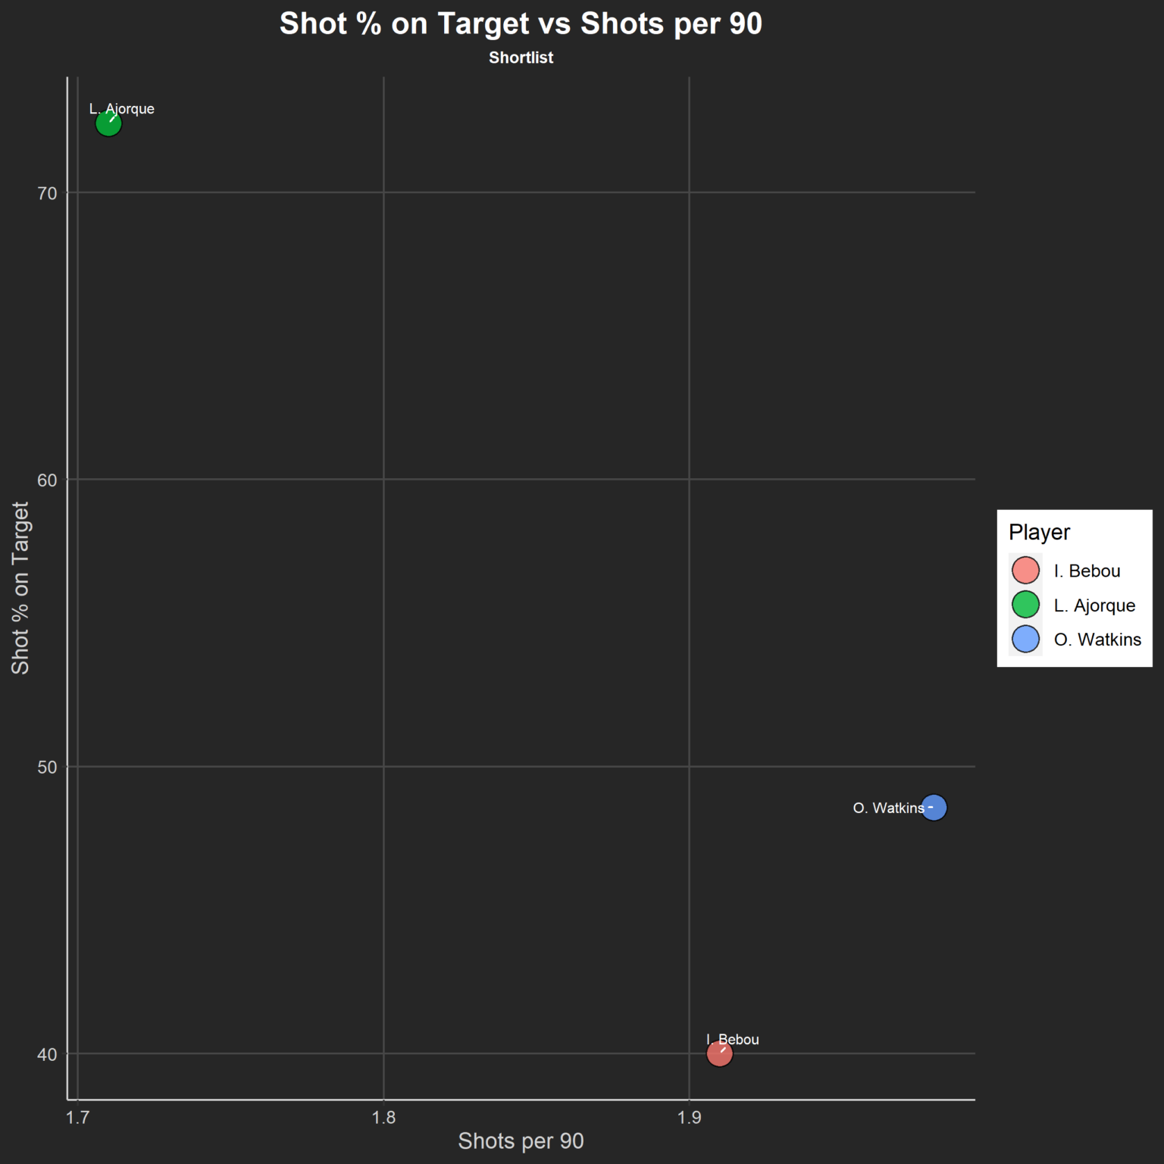
Deployment – A Premier League Club Looking to Sign a Center Forward
Although Ajorque has slightly less shots per 90 than Bebou and Watkins, he is extremely accurate with his shooting. Over 70% of his shots are on target. This is likely a major factor for his high goal tally.
Bebou is the least accurate shooter, finding the target around 40% of the time. Watkins is hitting the target just shy of 50%.

Slide 21
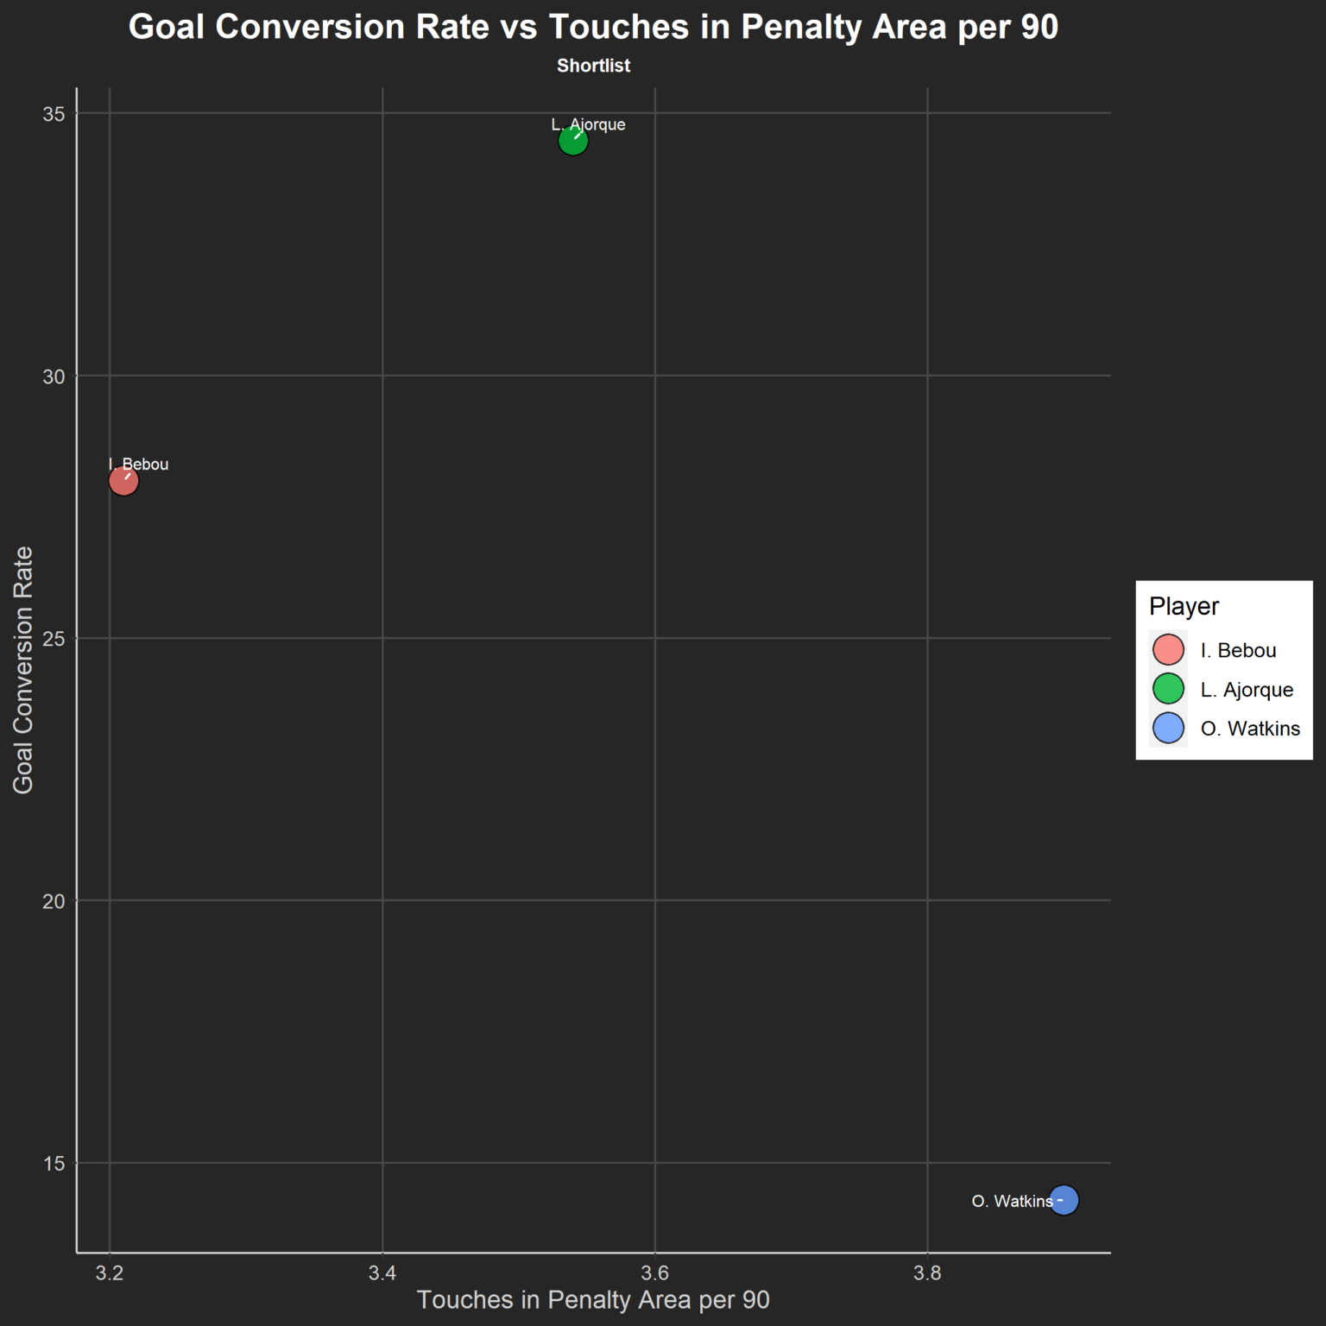
Deployment – A Premier League Club Looking to Sign a Center Forward
Watkins is finding himself getting more touches in the penalty area than both Ajorque and Bebou. This is important, as chances in the penalty area will typically lead to better goal scoring opportunities.
When it comes to efficiency in these dangerous areas, Watkins is not up to par. His goal conversion rate is below 15%, which is significantly lower than both Bebou and Ajorque.
On the contrary, Ajorque is extremely efficient. His goal conversion rate of 34% indicates that 34% of his shots are resulting in a goal.

Slide 22
Conclusion
In conclusion, the valuation labels generated for players provided accurate guidance when comparing in season performance relative to market value.
In the small minority of cases where valuation labels were rejected, such as Diop, a simple look at metrics in key areas will make the decision obvious.
Flexibility is key, as one can select the parameters they desire for a specific role. This allows us to generate a weighted score amongst players just for the features of that role.
This is a tool that should be paired with traditional methods, such as various in person scouting reports and player analysis.

